Slide 1
INTRODUCTION
Introduction to Programming – Nhập môn lập trình
Trương Toàn Thịnh

Slide 2
CONTENTS
Goals
Program
Compiler
Programming environment
Examples

Slide 3
GOALS
Understanding basic conceptions of programming language, for example C/C++.
Using techniques in C/C++ to deal with the practical/academic problem.
Knowing some programming strategy
Programming environment:
  Visual C++.NET 2013 → 2019.

Slide 4
GOALS
References:
  Kĩ thuật lập trình C – Prof Phạm Văn Ất
  Nhập môn lập trình – Prof Trần Đan Thư, PhD Nguyễn Thanh Phương, PhD Đinh Bá Tiến và Prof Trần Minh Triết.
  The C++ Programming Language – Bjame Stroustrup
  Introduction to Algorithms – Thomas H. Cormen, Charles E. Leiserson, Ronald L. Rivest, và Clifford Stein
  BÀI TẬP KỸ THUẬT LẬP TRÌNH – THẦY NGUYỄN TẤN TRẦN MINH KHANG

Slide 5
GOALS
Main contents
  Overview of computer programming
  Basic operators
  Control structure
  Modular programming
  Algorithm
  Conditional programming strategy
  Array
  Loop technique
  Structural datatype
  File – handling

Slide 6
CONTENTS
Goals
Program
Compiler
Programming environment
Examples

Slide 7
PROGRAM
What program is
  A sequence of instructions
  To solve practical/academic problems
Who programs is developer
There are two basic programs
  Machine code
  Assembly & assembler

Slide 8





PROGRAM
Process of machine code
Some limitations
  Depend on CPU
  Organized by OS
  Difficult to understand
Unable to directly program machine code
Run
Search
Load
Process

Slide 9





PROGRAM
Assembly is a low-level language
  Easier to understand than machine code
  Need Assembler to translate into machine code
Defect: depend on CPU
Merit: take advantage of CPU
File
assembly 1
Assembler A
File
assembly 2
Assembler B

Slide 10
PROGRAM
Traditional high – level programming language
  More abstract than assemly
  Easier to understand than assembly
  More compatible than assemly
Compiler B
High – level
Language
File
Compiler A

Slide 11
PROGRAM
There are many languages with various objectives
  Web applications: PHP, ASP.net, Ruby
  Administration systems: Java, C#
  Science computations: Fortran
  Machine learning algorithms: Python
  Operating systems: C/C++

Slide 12


PROGRAM
Limitation of traditional high–level programming languages: their compilers directly translate into machine code
The modern high–level programming languages’ compilers translate into intermediate code (byte–code)
Compiler
Byte - code
Modern high – level
language
File
Virtual machine

Slide 13
CONTENTS
Goals
Program
Compiler
Programming environment
Examples

Slide 14
COMPILER
There are two high – level ones
  Compiler
    All source code is performed syntax analysis
    Translates a programming language into another language (machine code + management information)
    Results saved on hard-disk are execution files
  Interpreter
    Checks syntax at each line of codes
    Perform its behavior directly

Slide 15
COMPILER
Process of compiling high–level language
  Developer chooses another text-editor to compose source – code
  Compiler translates it into target language (intermedia code)
  Linker connects all intermedia codes into executable files
  Run the program

Slide 16
COMPILER
Diagram
Compose & save
Source-code files
Translated by Compiler
Syntax analysis
Yes
Fix & save
No
Connected by Linker
Object files
Execution files

Slide 17
CONTENTS
Goals
Program
Compiler
Programming environment
Examples

Slide 18
PROGRAMMING ENVIRONMENT
A place where we perform some tasks, such as, compiling, linking (called Integrated Development Environment)
Main features
  Text Composing
  Source code management
  Version management
  Syntax analysis, compiling and linking
  Debug
  …
For instances: visual studio 2013, 2015, 2017

Slide 19
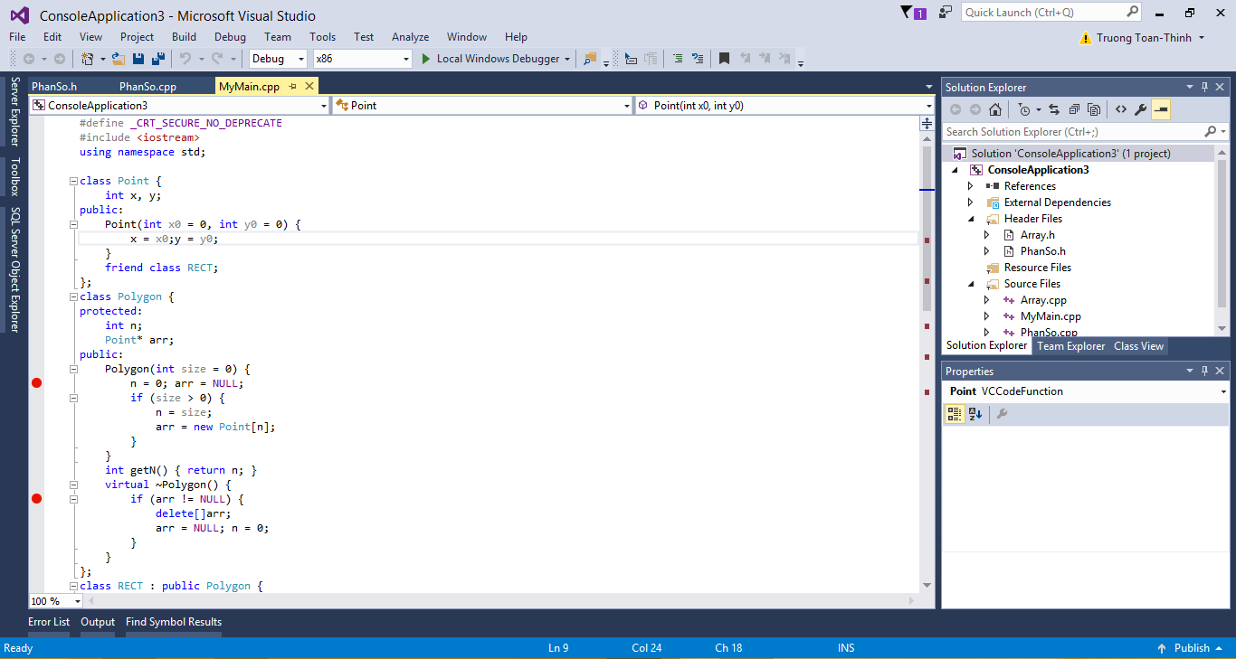
PROGRAMMING ENVIRONMENT

Slide 20
CONTENTS
Goals
Program
Compiler
Programming environment
Examples

Slide 21
EXAMPLES
Lines | Description
1 | //File Hello.c
2 | #include <stdio.h>
3 | void main()
4 | {
5 | printf(“Hello World!!!”); COUT << “HELLO WORLD”;
6 | }
Line 1: comment line
Line 2: include some libraries
Line 3: declare at the beginning
Line 4: symbol ‘{’ begins the definition
Line 5: print ‘Hello…’ to screen
Line 6: symbol ‘}’ finishes the definition

Slide 22
EXAMPLES
Lines | Description
1 | //File Hello.c
2 | #include <stdio.h>
3 | void main()
4 | {
5 | printf(“Hello World!!!\n”);
6 | printf(“I am a student”);
7 | }
Line 1: …
Line 2: …
Line 3: …
Line 4: …
Line 5: …
Line 6: …
Line 7: …

Slide 23
EXAMPLES
Lines | Description
1 | //File Sum.c
2 | #include <stdio.h>
3 | void main()
4 | {
5 | int a = 2, b = 3;
6 | int kq = a + b;
7 | printf(“Ket qua la: %d”, kq);
8 | }
Line 1, 2, 3, 4: …
Line 5: declare & define 2 integer variables called a & b valued 2 & 3
Line 6: declare & define integer variable kq valued the sum of a & b
Line 7: print the result kq to screen, representation string standing for integer variable is “%d”

Slide 24
EXAMPLES
Lines | Description
1 | //File Sum.c
2 | #include <stdio.h>
3 | void main()
4 | {
5 | int a , b;
6 | printf(“Nhap a: ”);
7 | scanf(“%d”, &a);
8
9
10 | int kq = …
11 | printf(“Ket qua la: %d”, kq);
12 | }

Slide 25
EXAMPLES
Lines | Description
1 | //File Subtract.c
2 | #include <stdio.h>
3 | void main()
4 | {
5 | int a , b;
6 | printf(“Nhap a: ”);
7 | scanf(“%d”, &a);
8
9
10 | int kq = …
11 | printf(“Ket qua la: %d”, kq);
12 | }

Slide 26
EXAMPLES
Lines | Description
1 | //File Sin.c
2 | #include <stdio.h>
3 | #include <math.h>
4 | void main()
5 | {
6 | double a ;
7 | printf(“Nhap a: ”);
8 | scanf(“%lf”, &a);
9 | double kq = sin(a);
10 | printf(“Ket qua la: %lf”, kq);
11 | }

Slide 27
EXAMPLES
Lines | Description
1 | //File Tinh_can_so.c
2 | #include <stdio.h>
3 | #include <math.h>
4 | void main()
5 | {
6 | double a ;
7 | printf(“Nhap a: ”);
8 | scanf(“%lf”, &a);
9 | double kq = …; // Ham tinh can so trong Math.h la sqrt()
10 | printf(“Ket qua la: %lf”, kq);
11 | }

Slide 28
EXAMPLES
Lines | Description
1 | //File Divide.c
2 | #include <stdio.h>
3 | void main()
4 | {
5 | double a , b;
6 | printf(“Nhap a: ”);
7 | scanf(“%lf”, &a);
8
9
10 | double kq = a/b;
11 | printf(“Ket qua la: %lf”, kq);
12 | }

